Slide 1
DIFFERENCE BETWEEN RASTER & VECTOR GRAPHIC

Slide 2
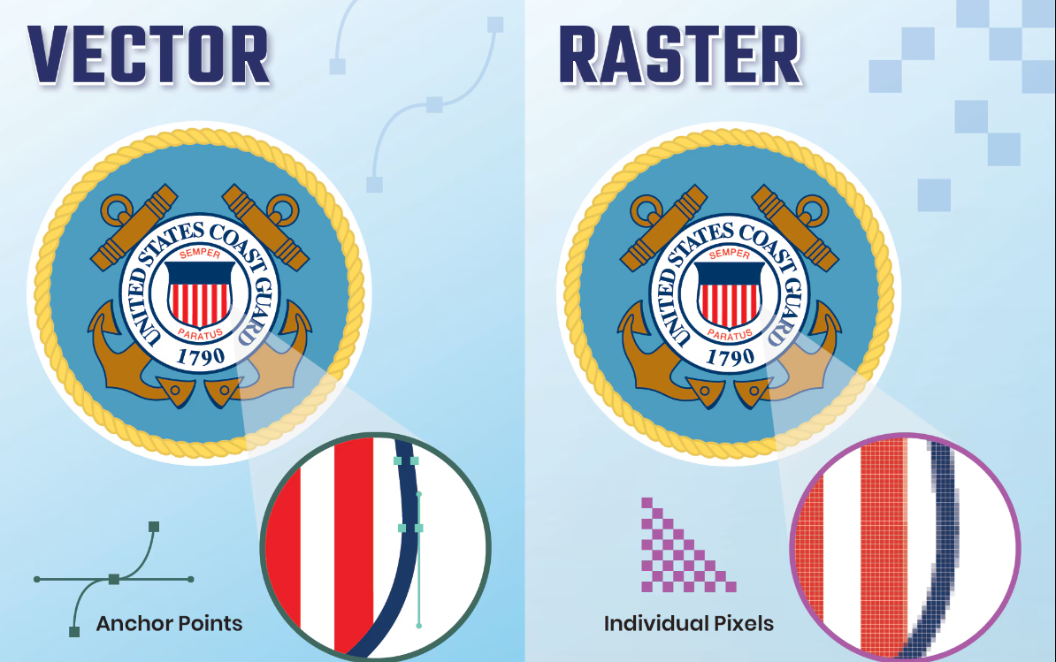


Slide 3


WHAT IS RASTER GRAPHIC?
A Raster Graphic Is An Image Made Of Tiny Squares Called Pixels. These Pixels Create The Picture, And When You Zoom In, You Can See Each Square.

Slide 4

WHAT IS VECTOR GRAPHIC?
A vector graphic is an image made of lines and shapes that can be resized without losing quality..

Slide 5
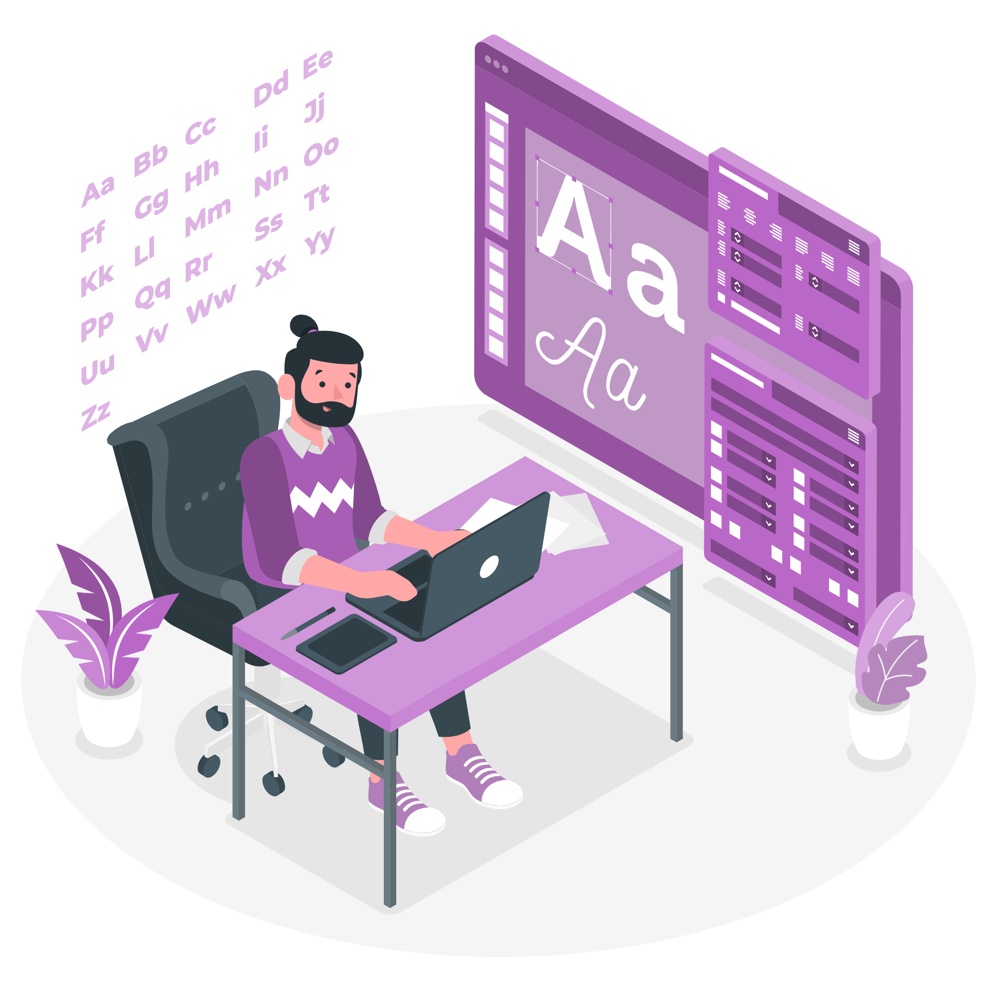
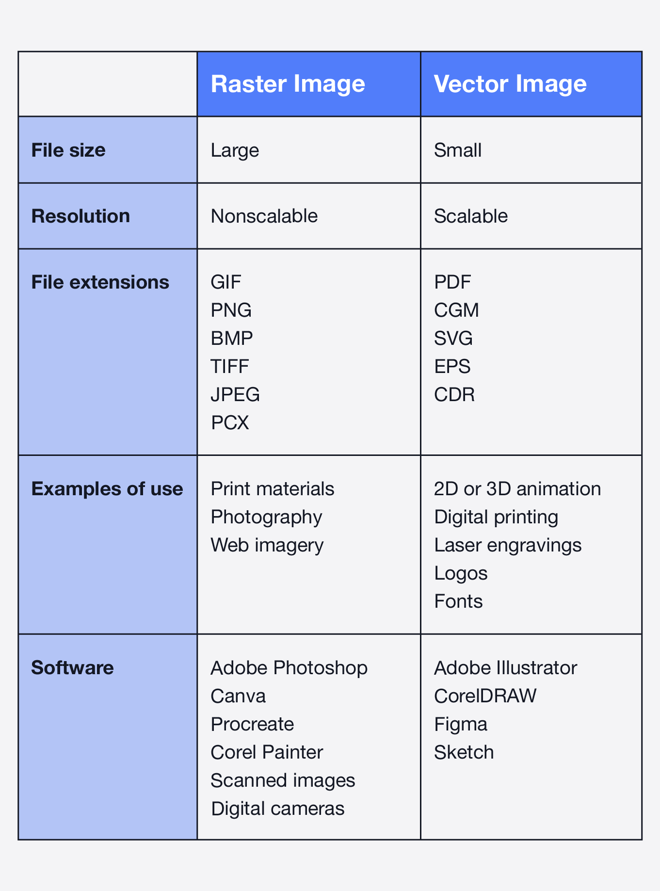

Slide 6

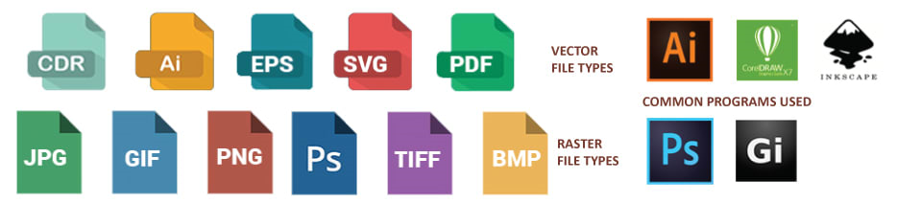

VECTOR FILE FORMATS
RASTER FILE FORMATS

Slide 7

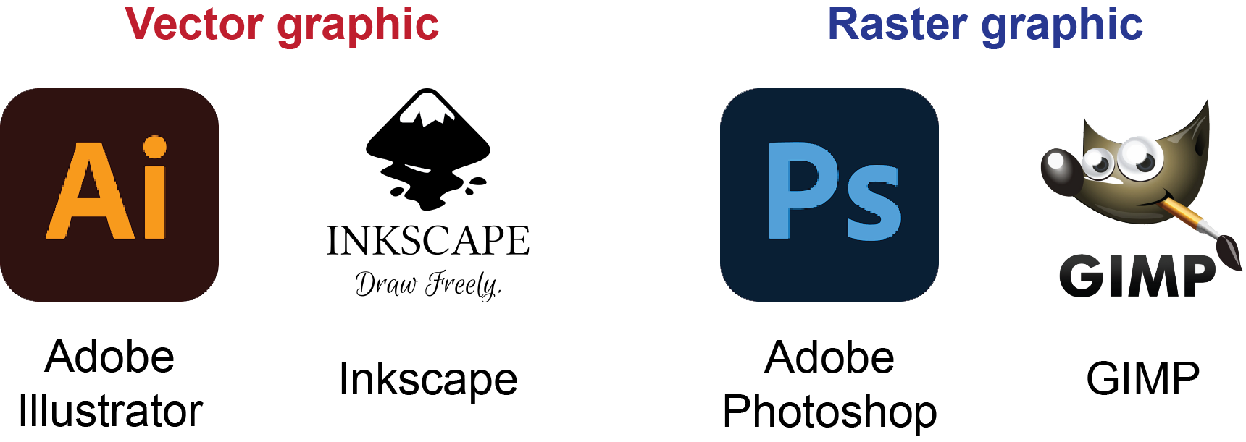

Slide 8
DETAILS ABOUT RASTER
In raster graphics, resolution refers to the number of pixels in an image, usually measured in pixels per inch (PPI) or dots per inch (DPI). Higher resolution means more pixels are packed into the image, which results in better detail and clarity. However, increasing resolution also makes the file size larger. If a raster image is enlarged without increasing the resolution, it can become blurry or pixelated because the same number of pixels are stretched over a larger area.

Slide 9
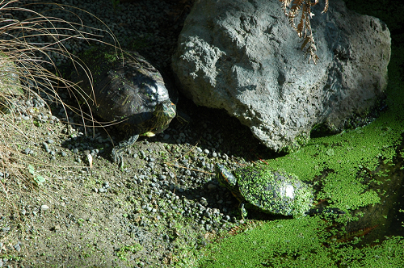
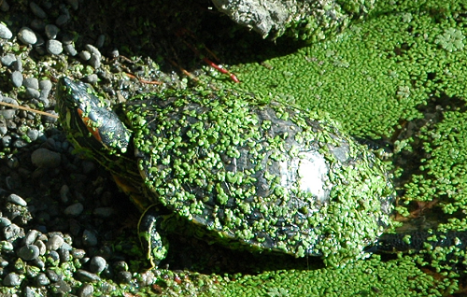
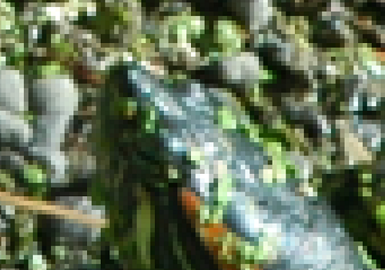
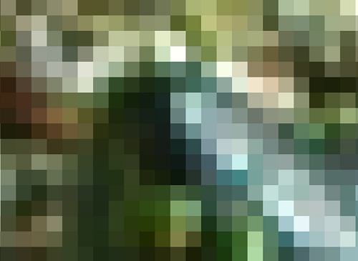

Slide 10
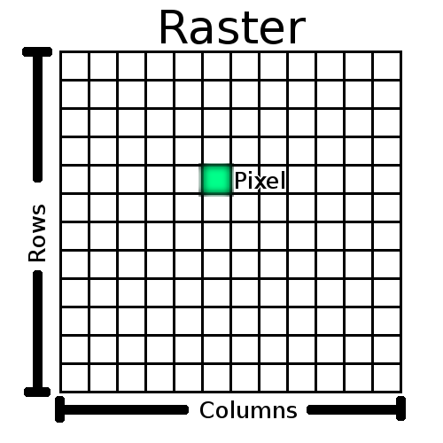
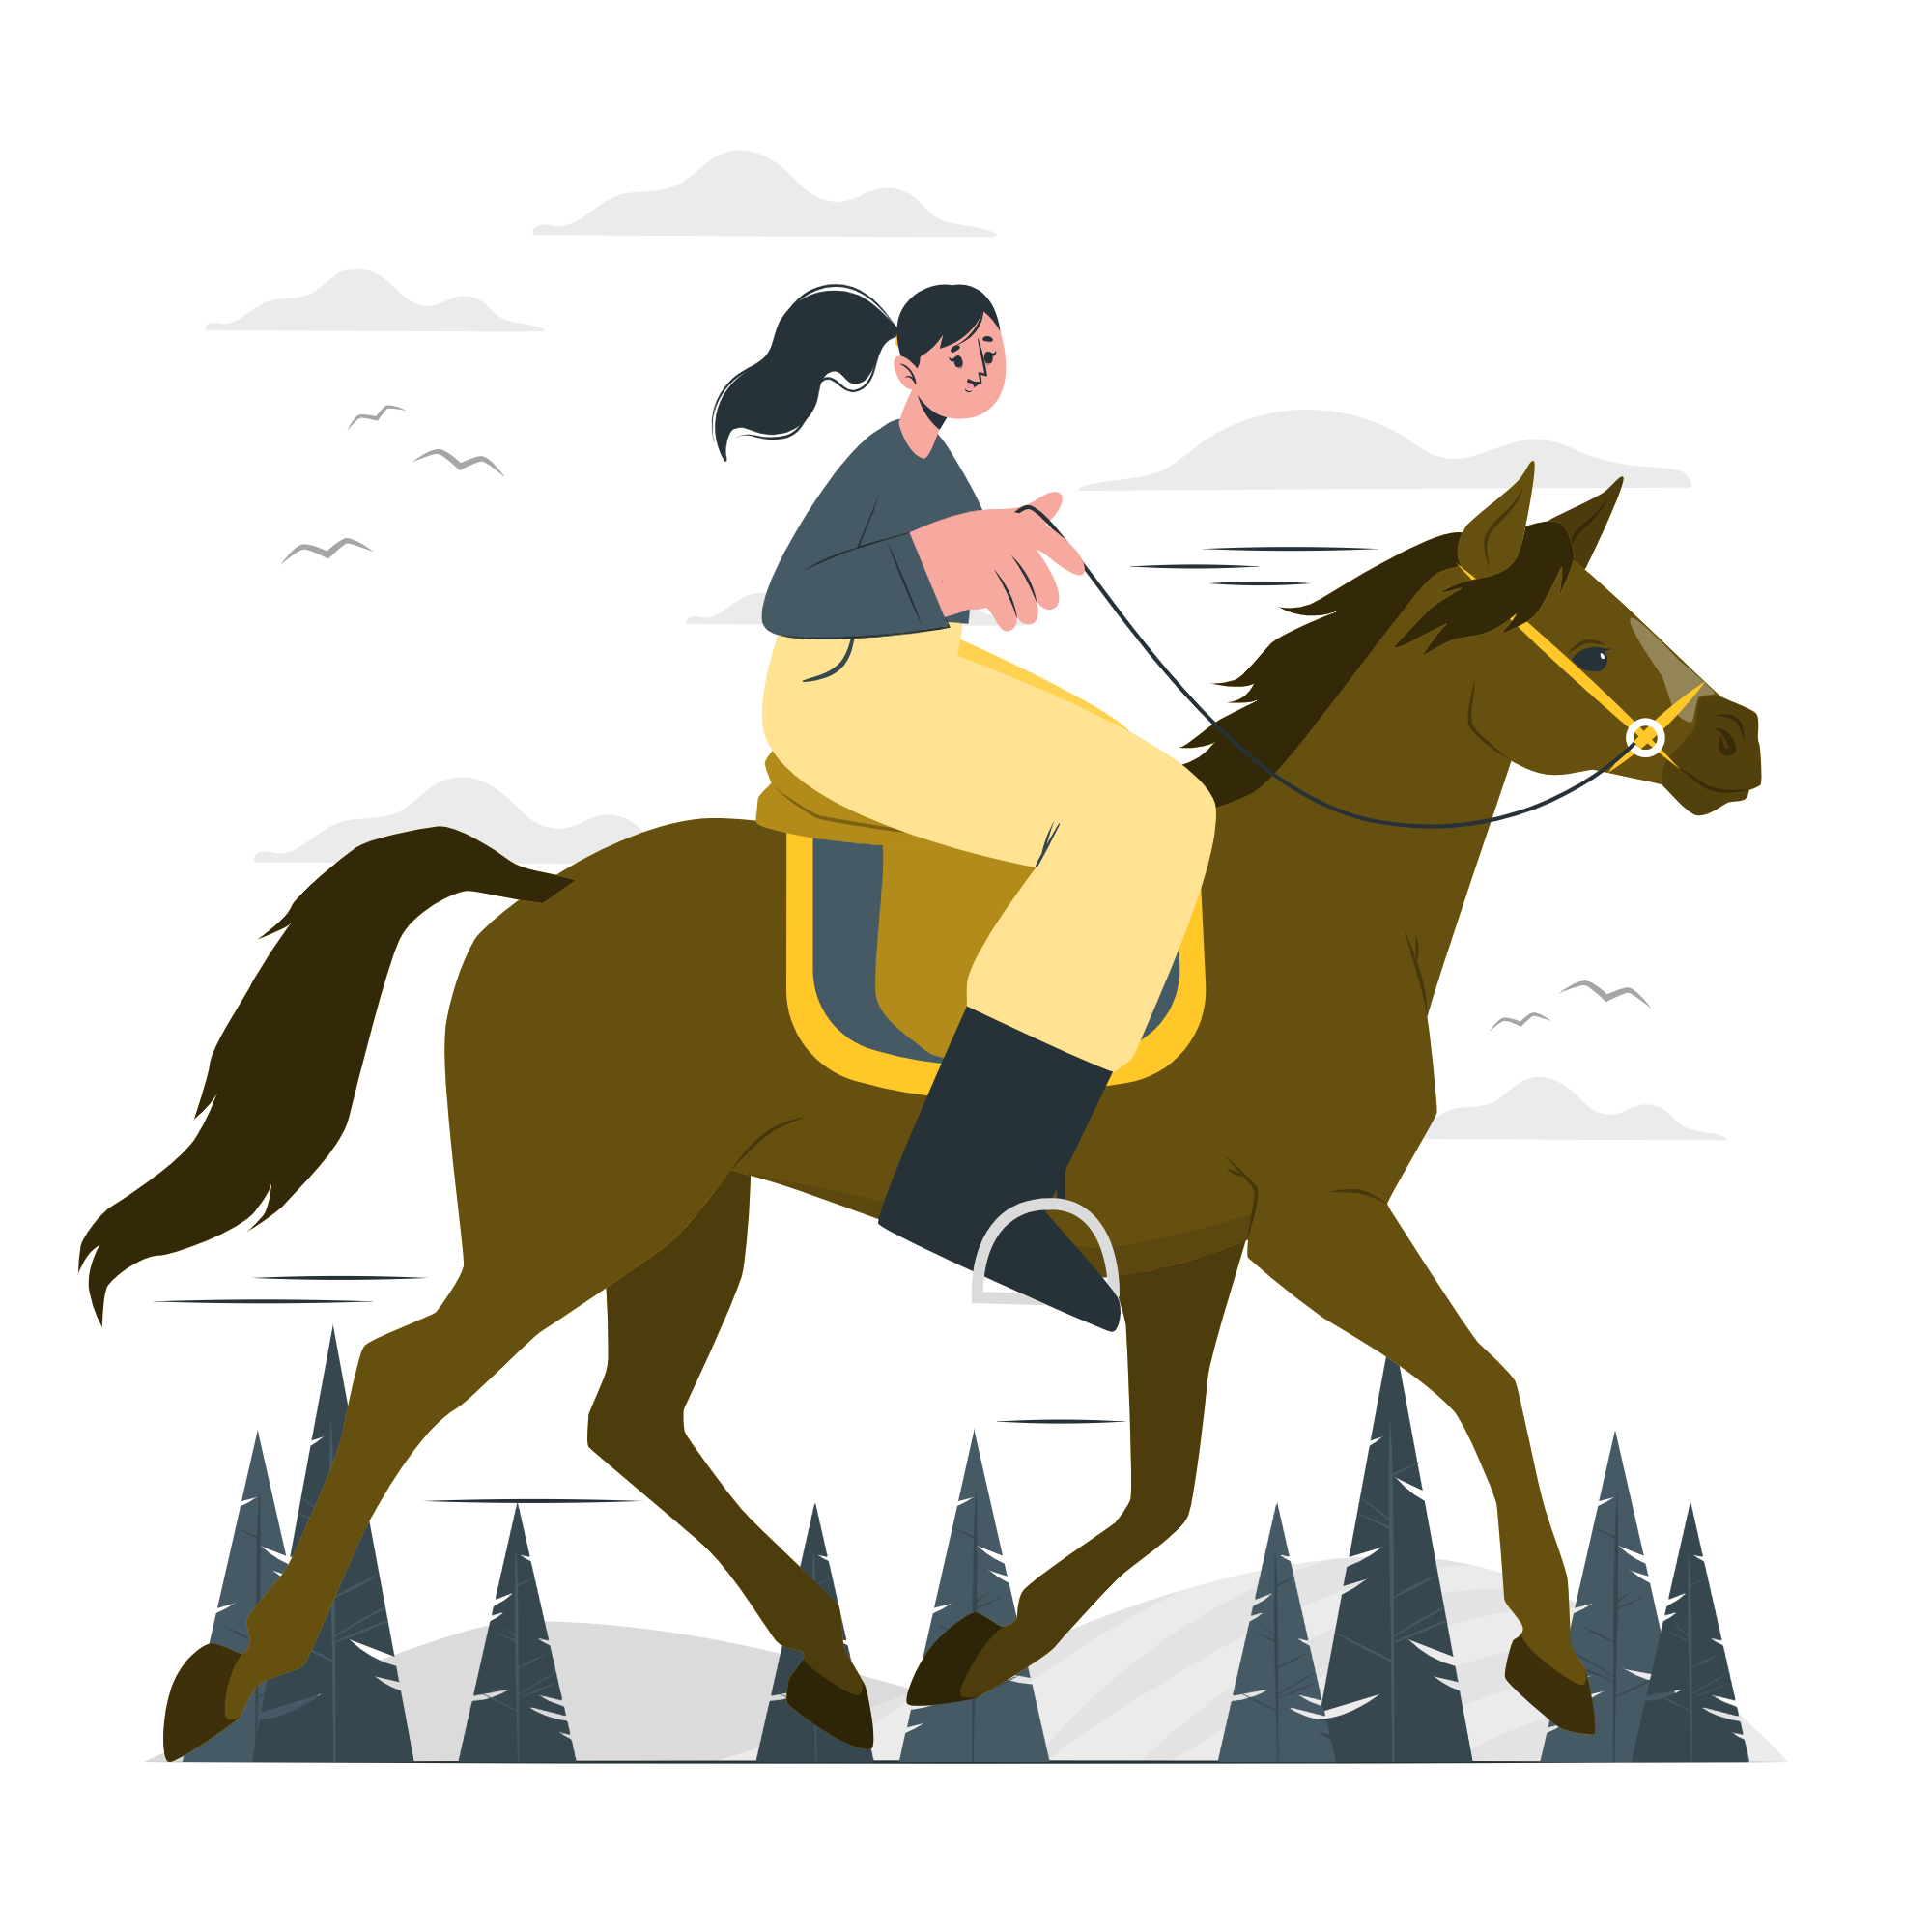

Slide 11
